Slide 1
About Data Analysis

Slide 2

Data Processing Pipeline
Define problem
data cleaning data preparation
acquire data
Model training/validation Feature Engineering
Prediction/interpretation solution

Slide 3
Elementary Feature Engieering
Feature Scaling:
Standardization : (x- mean)/sd
MinMax Scaling: (x- min)/(max-min)
Mean Scaling: (x-mean)/(max- min)
Max Absolute Scaling : x/max(|x|)
Unit norm-Scaling: x/||x||

Slide 4
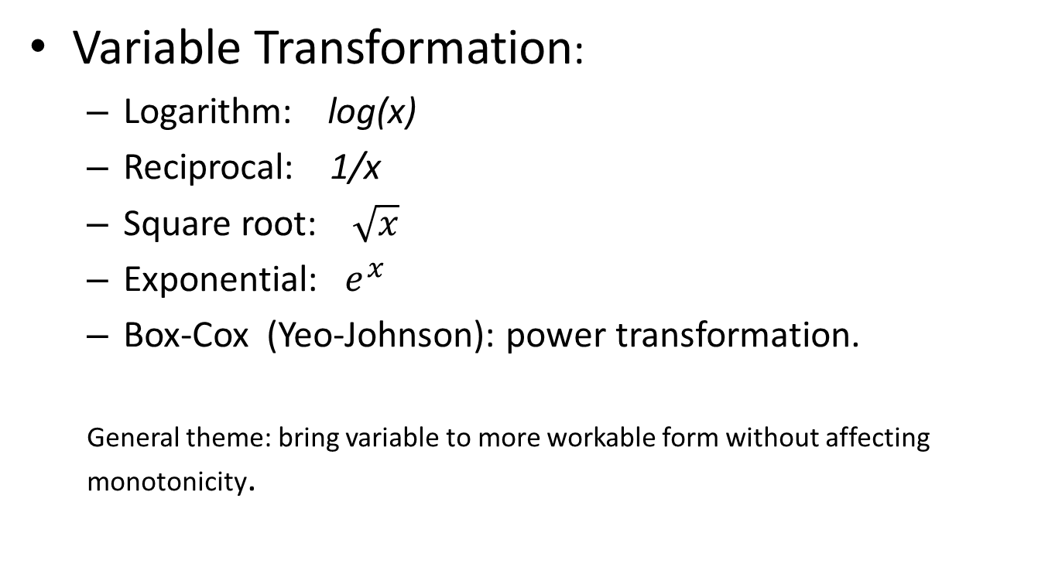
Variable Transformation:
Logarithm: log(x)
Reciprocal: 1/x
Square root: $\sqrt{x}$
Exponential: $e^{x}$
Box-Cox (Yeo-Johnson): power transformation.
General theme: bring variable to more workable form without affecting monotonicity.

Slide 5
Discretization:
Equal frequency discretization
Equal length discretization
Discretization with trees
Discretization with ChiMerge

Slide 6
Missing Data Imputation:
Complete case analysis
Mean / Median / Mode imputation
Random Sample Imputation
Replacement by Arbitrary Value
Missing Value Indicator
Multivariate imputation

Slide 7
Categorical Encoding:
One hot encoding
Count and Frequency encoding
Target encoding / Mean encoding
Ordinal encoding
Weight of Evidence
Rare label encoding
BaseN, feature hashing and others

Slide 8
Outlier Removal:
Removing outliers
Treating outliers as NaN
Capping, Winsorization

Slide 9
Date and Time Engineering:
Extracting days, months, years, quarters, time elapsed
Feature Creation:
Sum, subtraction, mean, min, max, product, quotient of group of features
Aggregating Transaction Data:
Same as above but in same feature over time window

Slide 10
More advance FeatEngi
Bin counting
Math transform: Fouriour, Laplace, wavelet, spectral.
Discretization with trees
Ranking, differencing, returns,
moving average, recency weighted moving average.
Imputing (MICE …)
Use of correlation, covariance
Mutual information

Slide 11
Similarity measures.
Use first few layers of nnets.
AutoEncoder, VAE, stacked auto-encoder,
Restricted Boltzman machine
Matrix factorization

Slide 12
Use of the membership of (e.g., K-means) clusters or distances to the hubs of clusters.
Meta features (R-pub functions)
Data augmentation
Representation learning …

Slide 13
General tips for FeatEngi
Use complex models for feature construction, and use simple models for final stacking.
Data understanding + creativity = Good featEngi
Lots of ideas (good or bad)
+ quick and efficient iteration/checking
+ double check data points where your predictions are poor
One important/sound expert idea => construct feature to reflect it => verify its goodness.
Learn “featureTools”.
Meta-feature (check R-pub).

Slide 14
Short list of Some ML/Stat models
Supervised Learning:
Linear regression
Nonlinear regression: local polynomial, spline,…
Generalized linear models: (e.g., logistic regression…)
KNN
Naive Bayes
LDA, QDA, ..
SVM …
Tree based … (eg., decision trees, random forest….)
Ensemble: … (e.g., bagging, boostings, stacking/blending…)
Neural nets …………………
……

Slide 15
Unsupervised learning:
PCA, ICA, ..
Factor analysis.
Cluster analysis.
Representation learning.
…

Slide 16
A few key techniques
Bayesian Methods
Model checking/Model selection/Model combination.
Validation/Cross validation.
Regularization: Lasso, ridge, slow-learning, early-stopping, dropout….
…

