Slide 1
Boyce/DiPrima 10th ed, Ch 10.2: Fourier Series Elementary Differential Equations and Boundary Value Problems, 10th edition, by William E. Boyce and Richard C. DiPrima, ©2013 by John Wiley & Sons, Inc.
We will see that many important problems involving partial differential equations can be solved, provided a given function can be expressed as an infinite sum of sines and cosines.
In this section and in the following two sections, we explain in detail how this can be done.
These trigonometric series are called Fourier series, and are somewhat analogous to Taylor series, in that both types of series provide a means of expressing complicated functions in terms of certain familiar elementary functions.

Slide 2
Fourier Series Representation of Functions
We begin with a series of the form
On the set of points where this series converges, it defines a function f whose value at each point x is the sum of the series for that value of x.
In this case the series is said to be the Fourier series of f.
Our immediate goals are to determine what functions can be represented as a sum of Fourier series, and to find some means of computing the coefficients in the series corresponding to a given function.

Slide 3
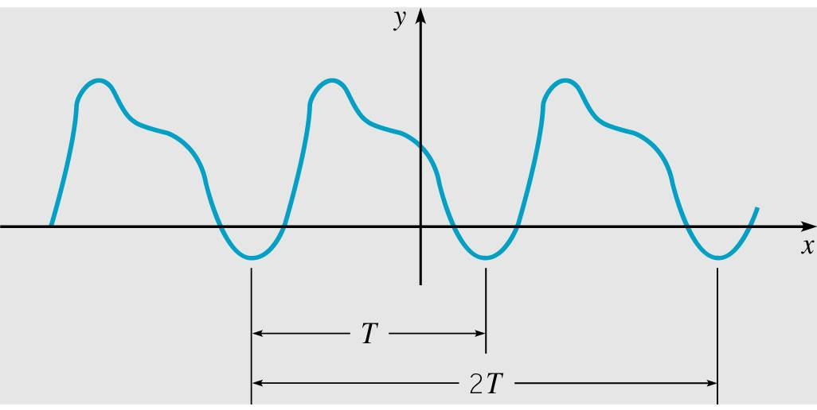
Periodic Functions
We first develop properties of sin(mπ x/L) and cos(mπ x/L), where m is a positive integer.
The first property is their periodic character.
A function is periodic with period T > 0 if the domain of f contains x + T whenever it contains x, and if
f (x + T) = f(x)
for all x. See graph below.

Slide 4
Periodicity of the Sine and Cosine Functions
For a periodic function of period T, f (x + T) = f(x) for all x.
Note that 2T is also a period, and so is any multiple of T.
The smallest value of T for which f is periodic is called the fundamental period of f.
If f and g are two periodic functions with common period T, then fg and c₁ f + c₂g are also periodic with period T.
In particular, sin(mπ x/L) and cos(mπ x/L) are periodic with period T = 2L/m.

Slide 5
Orthogonality
The standard inner product (u, v) of two real-valued functions u and v on the interval α ≤ x ≤ β is defined by
The functions u and v are orthogonal on α ≤ x ≤ β if their inner product (u, v) is zero:
A set of functions is mutually orthogonal if each distinct pair of functions in the set is orthogonal.

Slide 6
Orthogonality of Sine and Cosine
The functions sin(mπ x/L) and cos(mπ x/L), m = 1, 2, …, form a mutually orthogonal set of functions on -L ≤ x ≤ L, with
These results can be obtained by direct integration; see text.

Slide 7
Finding Coefficients in Fourier Expansion
Suppose the series converges, and call its sum f(x):
The coefficients a_{n}, n = 1, 2, …, can be found as follows.
By orthogonality,

Slide 8
Coefficient Formulas
Thus from the previous slide we have
To find the coefficient a₀, we have
Thus the coefficients a_{n} are given by
Similarly, the coefficients b_{n} are given by

Slide 9
The Euler-Fourier Formulas
Thus the coefficients are given by the equations
which are known as the Euler-Fourier formulas.
Note that these formulas depend only on the values of f(x) in the interval -L ≤ x ≤ L. Since each term of the Fourier series
is periodic with period 2L, the series converges for all x when it converges in -L ≤ x ≤ L, and f is determined for all x by its values in -L ≤ x ≤ L.

Slide 10
Example 1: Triangular Wave (1 of 3)
Consider the function below.
This function represents a triangular wave, and is periodic with period T = 4. See graph of f below. In this case, L = 2.
Assuming that f has a Fourier series representation, find the coefficients a_{m} and b_{m}.

Slide 11
Example 1: Coefficients (2 of 3)
First, we find a₀:
Then for a_{m}, m = 1, 2, …, we have
where we have used integration by parts. See text for details.
Similarly, it can be shown that b_{m}= 0, m = 1, 2, …

Slide 12
Example 1: Fourier Expansion (3 of 3)
Thus b_{m}= 0, m = 1, 2, …, and
Then

Slide 13
Example 2: Function (1 of 4)
Consider the function below.
This function is periodic with period T = 6. In this case, L = 3.
Assuming that f has a Fourier series representation, find the coefficients a_{n} and b_{n}.

Slide 14
Example 2: Discontinuous Points (2 of 4)
Note that f(x) is not assigned values at the points of discontinuity, such as x = -1 or x = 1.
This has no effect on the values of the Fourier coefficients, because they result from the evaluation of integrals, and the value of an integral is not affected by the value of the integrand at a single point, or at a finite number of points.
Thus, the coefficients are the same regardless of what value, if any, f(x) is assigned at a point of discontinuity.

Slide 15
Example 2: Coefficients (3 of 4)
First, we find a₀:
Using the Euler-Fourier formulas, we obtain

Slide 16
Example 2: Fourier Expansion (4 of 4)
Thus b_{n}= 0, n = 1, 2, …, and
Then

Slide 17
Example 3: Triangular Wave (1 of 5)
Consider again the function from Example 1
as graphed below, and its Fourier series representation
We now examine speed of convergence by finding the number of terms needed so that the error is less than 0.01 for all x.

Slide 18
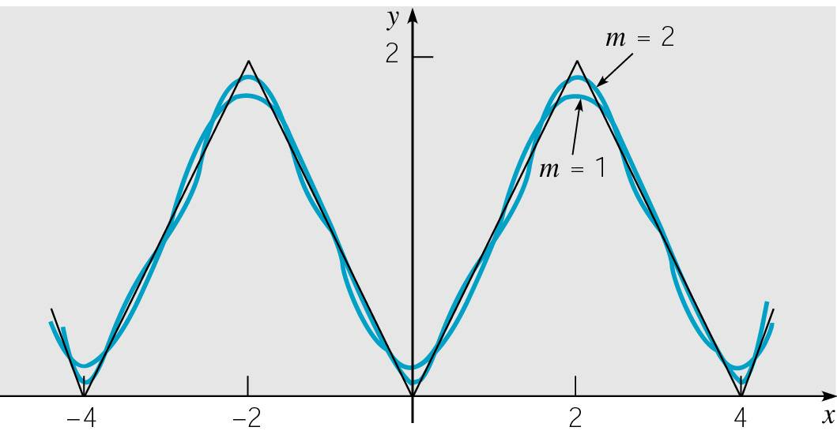
Example 3: Partial Sums (2 of 5)
The mth partial sum in the Fourier series is
and can be used to approximate the function f.
The coefficients diminish as (2n -1)², so the series converges fairly rapidly. This is seen below in the graph of s₁, s₂, and f.

Slide 19
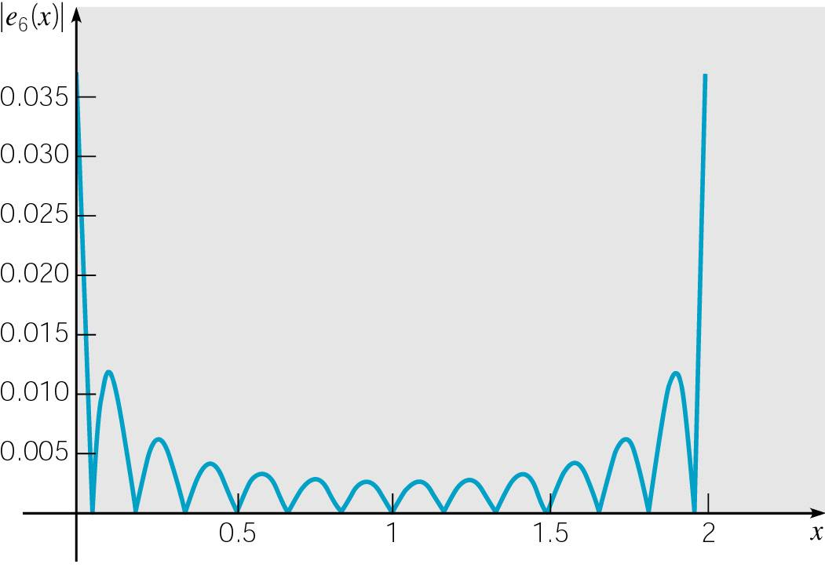
Example 3: Errors (3 of 5)
To investigate the convergence in more detail, we consider the error function e_{m}(x) = f (x) - s_{m}(x).
Given below is a graph of |e₆(x)| on 0 ≤ x ≤ 2.
Note that the error is greatest at x = 0 and x = 2, where the graph of f(x) has corners.
Similar graphs are obtained for other values of m.

Slide 20
Example 3: Uniform Bound (4 of 5)
Since the maximum error occurs at x = 0 or x = 2, we obtain a uniform error bound for each m by evaluating |e_{m}(x)| at one of these points.
For example, e₆(2) = 0.03370, and hence |e₆(x)| < 0.034 on 0 ≤ x ≤ 2, and consequently for all x.

Slide 21
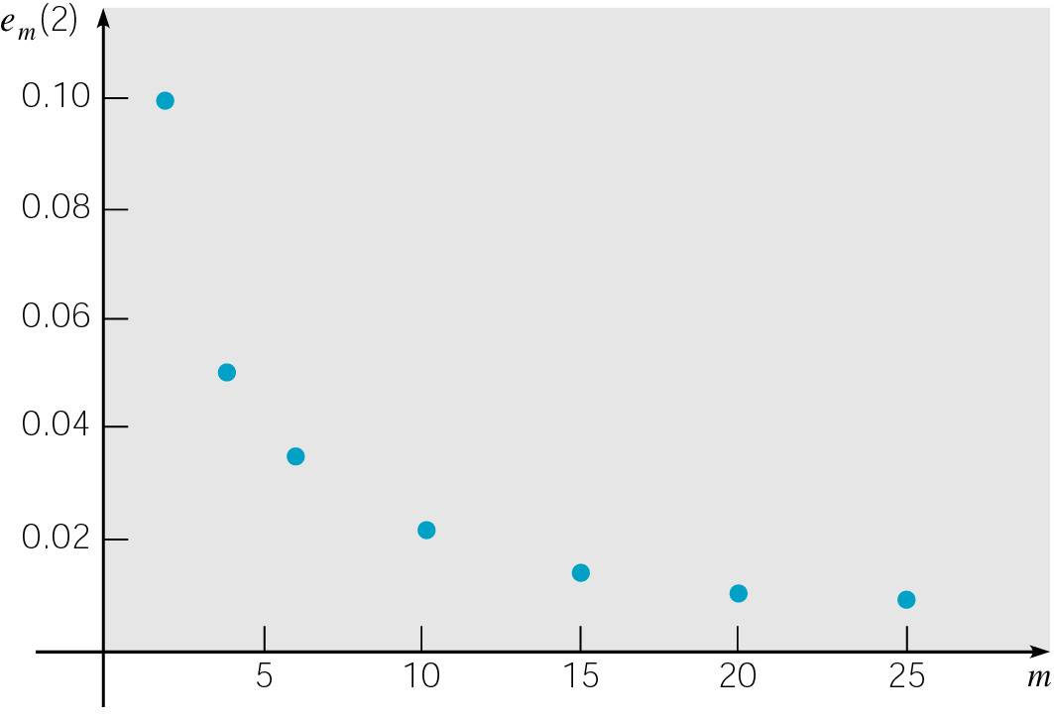
Example 3: Speed of Convergence (5 of 5)
The table below shows values of |e_{m}(2)| for other values of m, and these data points are plotted below also.
From this information, we can begin to estimate the number of terms that are needed to achieve a given level of accuracy.
To guarantee that |e_{m}(2)| ≤ 0.01, we need to choose m = 21.

Slide 22
Broad Use of Fourier Series
We will be using Fourier series as a means of solving certain problems in partial differential equations.
However, Fourier series have much wider application in science and engineering, and in general are valuable tools in the investigations of periodic phenomena.
For example, a basic problem in spectral analysis is to resolve an incoming signal into its harmonic components, which amounts to constructing its Fourier series representation.
In some frequency ranges the separate terms correspond to different colors or to different audible tones.
The magnitude of the coefficient determines the amplitude of each component.

