Slide 1
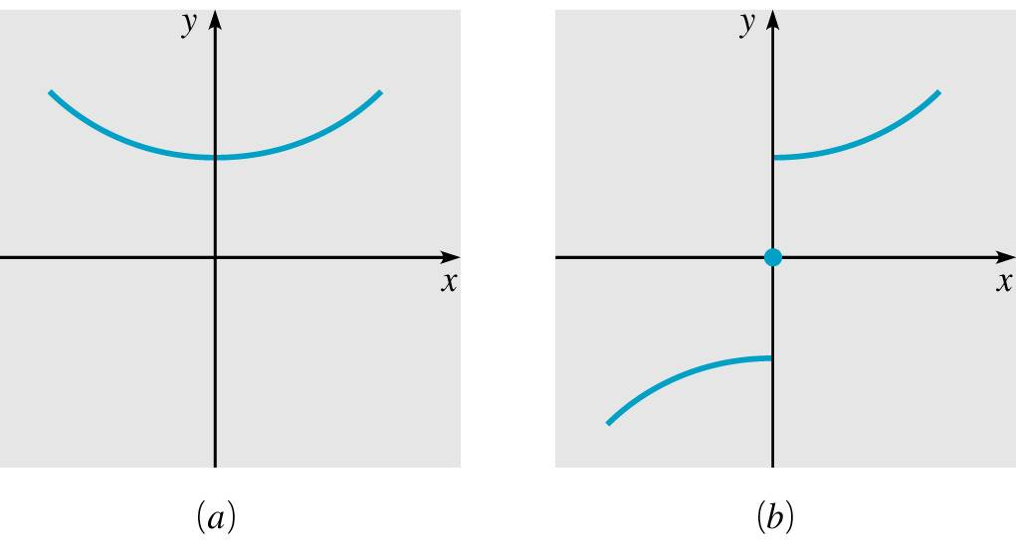
Boyce/DiPrima 10th ed, Ch 10.4: Even and Odd Functions Elementary Differential Equations and Boundary Value Problems, 10th edition, by William E. Boyce and Richard C. DiPrima, ©2013 by John Wiley & Sons, Inc.
Before looking at further examples of Fourier series it is useful to distinguish two classes of functions for which the Euler-Fourier formulas for the coefficients can be simplified.
The two classes are even and odd functions, which are characterized geometrically by the property of symmetry with respect to the y-axis and the origin, respectively.

Slide 2
Definition of Even and Odd Functions
Analytically, f is an even function if its domain contains the point –x whenever it contains x, and if f (-x) = f (x) for each x in the domain of f. See figure (a) below.
The function f is an odd function if its domain contains the point –x whenever it contains x, and if f (-x) = - f (x) for each x in the domain of f. See figure (b) below.
Note that f (0) = 0 for an odd function.
Examples of even functions
are 1, x², cos x, |x|.
Examples of odd functions
are x, x³, sin x.

Slide 3
Arithmetic Properties
The following arithmetic properties hold:
The sum (difference) of two even functions is even.
The product (quotient) of two even functions is even.
The sum (difference) of two odd functions is odd.
The product (quotient) of two odd functions is even.
These properties can be verified directly from the definitions, see text for details.

Slide 4
Integral Properties
If f is an even function, then
If f is an odd function, then
These properties can be verified directly from the definitions, see text for details.

Slide 5
Cosine Series
Suppose that f and f ' are piecewise continuous on [-L, L) and that f is an even periodic function with period 2L.
Then f(x) cos(nπ x/L) is even and f(x) sin(nπ x/L) is odd. Thus
It follows that the Fourier series of f is
Thus the Fourier series of an even function consists only of the cosine terms (and constant term), and is called a Fourier cosine series.

Slide 6
Sine Series
Suppose that f and f ' are piecewise continuous on [-L, L) and that f is an odd periodic function with period 2L.
Then f(x) cos(nπ x/L) is odd and f(x) sin(nπ x/L) is even. Thus
It follows that the Fourier series of f is
Thus the Fourier series of an odd function consists only of the sine terms, and is called a Fourier sine series.

Slide 7
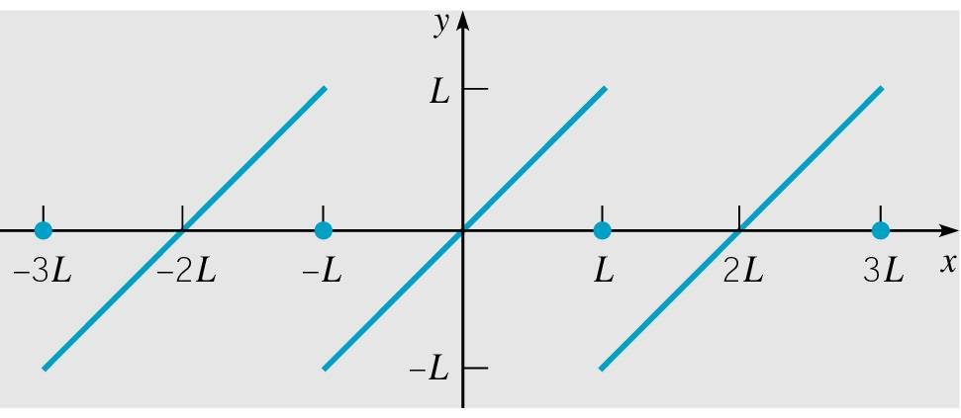
Example 1: Sawtooth Wave (1 of 3)
Consider the function below.
This function represents a sawtooth wave, and is periodic with period T = 2L. See graph of f below.
Find the Fourier series representation for this function.

Slide 8
Example 1: Coefficients (2 of 3)
Since f is an odd periodic function with period 2L, we have
It follows that the Fourier series of f is

Slide 9
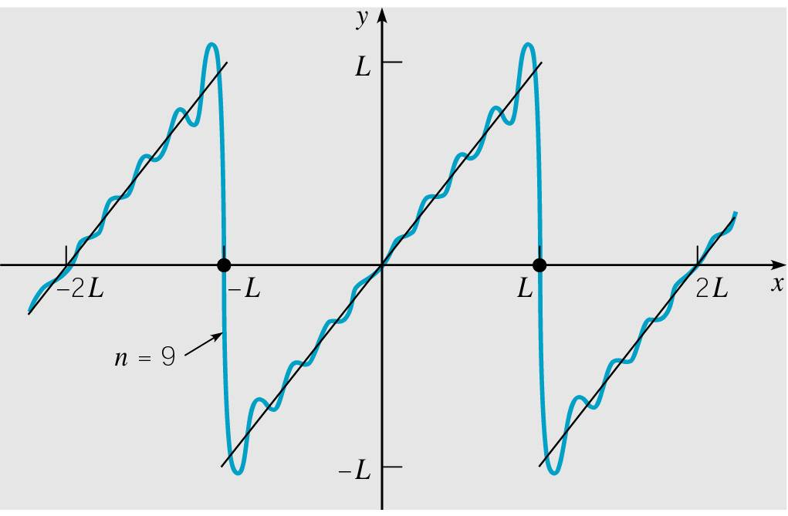
Example 1: Graph of Partial Sum (3 of 3)
The graphs of the partial sum s₉(x) and f are given below.
Observe that f is discontinuous at x = ±(2n +1)L, and at these points the series converges to the average of the left and right limits (as given by Theorem 10.3.1), which is zero.
The Gibbs phenomenon again occurs near the discontinuities.

Slide 10
Even Extensions
It is often useful to expand in a Fourier series of period 2L a function f originally defined only on [0, L], as follows.
Define a function g of period 2L so that
The function g is the even periodic extension of f. Its Fourier series, which is a cosine series, represents f on [0, L].
For example, the even periodic extension of f (x) = x on [0, 2] is the triangular wave g(x) given below.

Slide 11
Odd Extensions
As before, let f be a function defined only on (0, L).
Define a function h of period 2L so that
The function h is the odd periodic extension of f. Its Fourier series, which is a sine series, represents f on (0, L).
For example, the odd periodic extension of f (x) = x on [0, L) is the sawtooth wave h(x) given below.

Slide 12
General Extensions
As before, let f be a function defined only on [0, L].
Define a function k of period 2L so that
where m(x) is a function defined in any way consistent with Theorem 10.3.1. For example, we may define m(x) = 0.
The Fourier series for k involves both sine and cosine terms, and represents f on [0, L], regardless of how m(x) is defined.
Thus there are infinitely many such series, all of which converge to f on [0, L].

Slide 13
Example 2
Consider the function below.
As indicated previously, we can represent f either by a cosine series or a sine series on [0, 2]. Here, L = 2.
The cosine series for f converges to the even periodic extension of f of period 4, and this graph is given below left.
The sine series for f converges to the odd periodic extension of f of period 4, and this graph is given below right.

