Slide 1
Boyce/DiPrima 10th ed, Ch 10.5: Separation of Variables; Heat Conduction in a Rod Elementary Differential Equations and Boundary Value Problems, 10th edition, by William E. Boyce and Richard C. DiPrima, ©2013 by John Wiley & Sons, Inc.
The basic partial differential equations of heat conduction, wave propagation, and potential theory that we discuss in this chapter are associated with three distinct types of physical phenomena: diffusive processes, oscillatory processes, and time-independent or steady processes.
Consequently, they are of fundamental importance in many branches of physics, and are significant mathematically.
The partial differential equations whose theory is best developed and whose applications are most significant and varied are the linear equations of second order.
All such equations can be classified as one of three types:
The heat equation, the wave equation, and the potential equation, are prototypes of these categories.

Slide 2
Heat Conduction in a Rod: Assumptions (1 of 6)
Consider a heat equation conduction problem for a straight bar of uniform cross section and homogeneous material.
Let the x-axis be chosen to lie along the axis of the bar, and let x = 0 and x = L denote the ends of the bar. See figure below.
Suppose that the sides of the bar are perfectly insulated so that no heat passes through them.
Assume the cross-sectional dimensions are so small that the temperature u can be considered constant on the cross sections.
Then u is a function only of the axial coordinate x and time t.

Slide 3
Heat Conduction Equation (2 of 6)
The variation of temperature in the bar is governed by the heat conduction equation, and has the form
where α² is a constant known as the thermal diffusivity.
The parameter α² depends only on the material from which the bar is made, and is defined by α² = κ/ρs, where κ is the thermal conductivity, ρ is the density, and s is the specific heat of the material in the bar. The units of α² are (length)²/time.
See Table 10.5.1 in text for typical values of α² for some common materials.

Slide 4
Heat Conduction: Initial and Boundary Conditions (3 of 6)
In addition, we assume that the initial temperature distribution in the bar is given, and hence
where f is a given function.
Finally, we assume that the ends of the bar are held at fixed temperatures: the temperature T₁ at x = 0 and T₂ at x = L.
However, as will be shown in Section 10.6, we need only consider T₁ = T₂ = 0.
Thus we have the boundary conditions

Slide 5
Heat Conduction Problem (4 of 6)
Thus the fundamental problem of heat conduction is to find u(x,t) satisfying
With respect to the time variable t, this is an initial value problem; an initial condition is given and the differential equation governs what happens later.
With respect to the spatial variable x, it is a boundary value problem; boundary conditions are imposed at each end of the bar and the differential equation describes the evolution of the temperature in the interval between them.

Slide 6
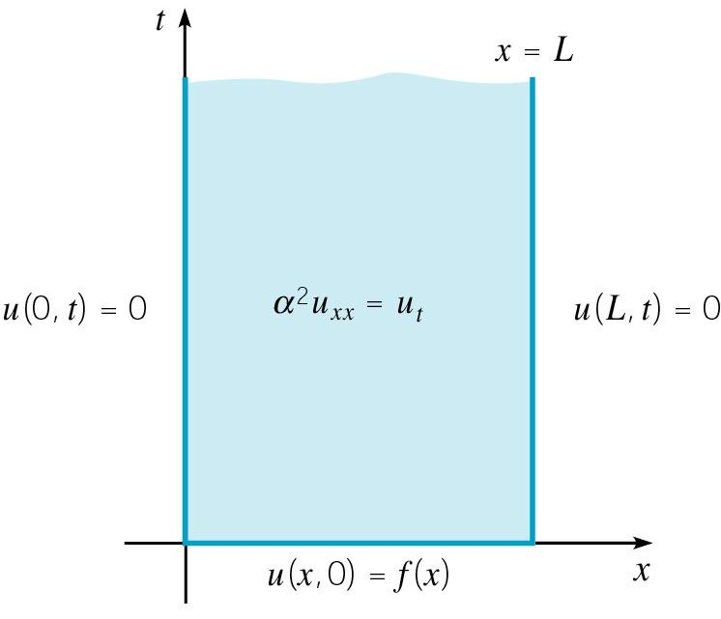
Heat Conduction: Boundary Problem (5 of 6)
Alternatively, we can consider the problem as a boundary value problem in the xt-plane, see figure below.
The solution u(x,t) satisfying the heat conduction problem is sought in the semi-definite strip 0 < x < L, t > 0, subject to the requirement that u(x,t) must assume a prescribed value at each point on the boundary of this strip.

Slide 7
Heat Conduction: Linear Homogeneous Equation (6 of 6)
The heat conduction problem
is linear since u appears only to the first power throughout.
The differential equation and boundary conditions are also homogeneous.
This suggests that we might approach the problem by seeking solutions of the differential equation and boundary conditions, and then superposing them to satisfy the initial condition.
We next describe how this plan can be implemented.

Slide 8
Separation of Variables Method (1 of 7)
Our goal is to find nontrivial solutions to the differential equation and boundary conditions.
We begin by assuming that the solution u(x,t) has the form
Substituting this into our differential equation
we obtain
or

Slide 9
Ordinary Differential Equations (2 of 7)
We have
Note left side depends only on x and right side only on t.
Thus in order for this equation to be valid for 0 < x < L, t > 0, it is necessary for both sides of this equation to equal the same constant, call it -λ. Then
Thus the partial differential equation is replaced by two ordinary differential equations.

Slide 10
Boundary Conditions (3 of 7)
Recall our original problem
Substituting u(x,t) = X(x)T(t) into boundary condition at x = 0,
Since we are interested in nontrivial solutions, we require X(0) = 0 instead of T(t) = 0 for t > 0. Similarly, X(L) = 0.
We therefore have the following boundary value problem

Slide 11
Eigenvalues and Eigenfunctions (4 of 7)
Thus
From Section 10.1, the only nontrivial solutions to this boundary value problem are the eigenfunctions
associated with the eigenvalues
With these values for λ, the solution to the first order equation
is

Slide 12
Fundamental Solutions (5 of 7)
Thus our fundamental solutions have the form
where we neglect arbitrary constants of proportionality.
The functions u_{n} are sometimes called fundamental solutions of the heat conduction problem.
It remains only to satisfy the initial condition
Recall that we have often solved initial value problems by forming linear combinations of fundamental solutions and then choosing the coefficients to satisfy the initial conditions.
Here, we have infinitely many fundamental solutions.

Slide 13
Fourier Coefficients (6 of 7)
Our fundamental solutions are
Recall the initial condition
We therefore assume that
where the c_{n} are chosen so that the initial condition is satisfied:
Thus we choose the coefficients c_{n} for a Fourier sine series.

Slide 14
Solution (7 of 7)
Therefore the solution to the heat conduction problem
is given by
where

Slide 15
Example 1: Heat Conduction Problem (1 of 6)
Find the temperature u(x,t) at any time in a metal rod 50 cm long, insulated on the sides, which initially has a uniform temperature of 20° C throughout and whose ends are maintained at 0° C for all t > 0.
This heat conduction problem has the form

Slide 16
Example 1: Solution (2 of 6)
The solution to our heat conduction problem is
where
Thus

Slide 17
Example 1: Rapid Convergence (3 of 6)
Thus the temperature along the rod is given by
The negative exponential factor in each term cause the series to converge rapidly, except for small values of t or α².
Therefore accurate results can usually be obtained by using only a few terms of the series.
In order to display quantitative results, let t be measured in seconds; then α² has the units cm²/sec.
If we choose α² = 1 for convenience, then the rod is of a material whose properties are somewhere between copper and aluminum (see Table 10.5.1).

Slide 18
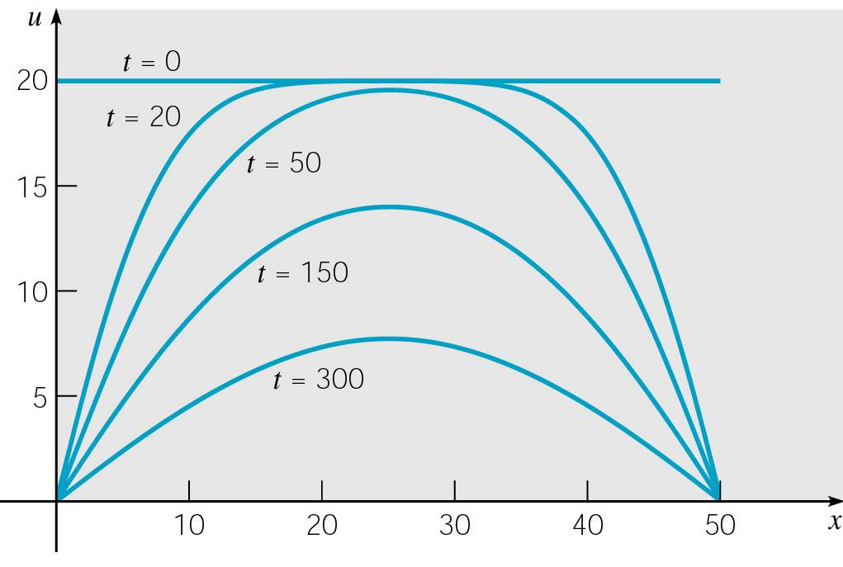
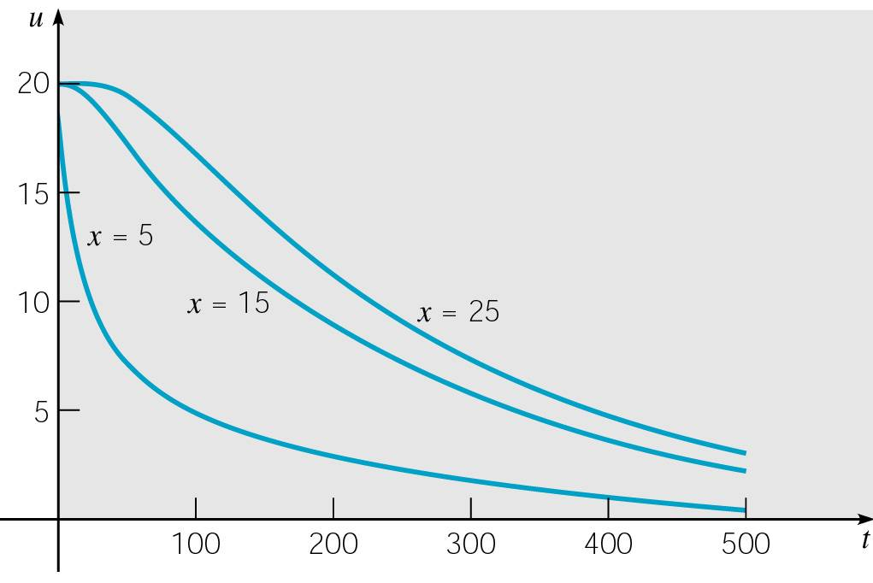
Example 1: Temperature Graphs (4 of 6)
The graph of the temperature distribution in the bar at several times is given below on the left.
Observe that the temperature diminishes steadily as heat in the bar is lost through the end points.
The way in which the temperature decays at a given point is plotted in the graph below on the right, where temperature is plotted against time for a few selected points in the bar.

Slide 19
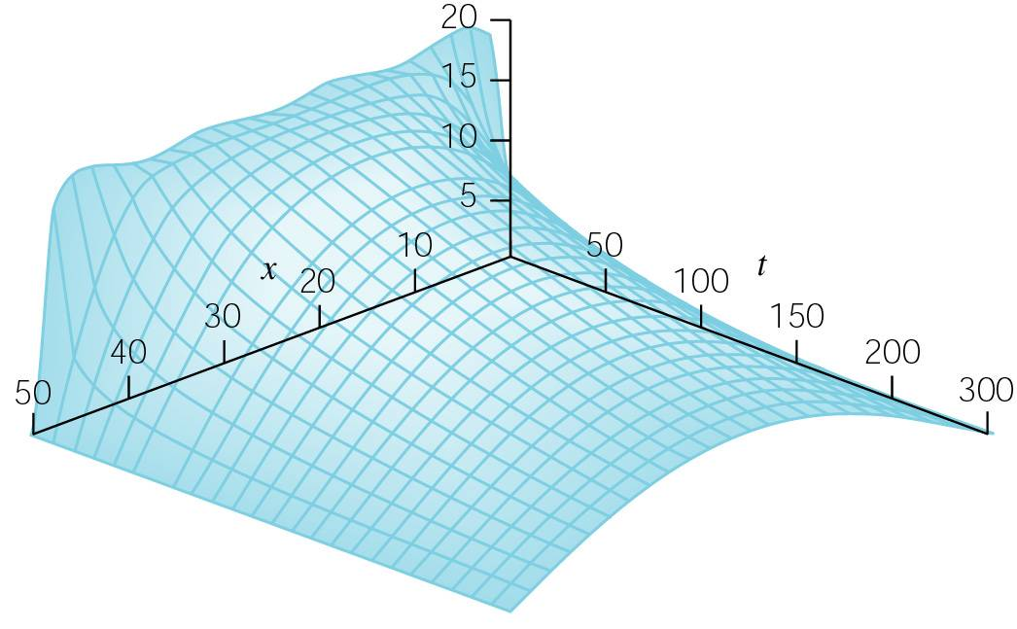
Example 1: Graph of u(x,t) (5 of 6)
A three-dimensional plot of u versus x and t is given below.
Observe that we obtain the previous graphs by intersecting the surface below by planes on which either t or x is constant.
The slight waviness in the graph below at t = 0 results from using only a finite number of terms in the series for u(x,t) and from the slow convergence of the series for t = 0.

Slide 20
Example 1: Time Until Temperature Reaches 1° C (6 of 6)
Recall that the solution to our heat conduction problem is
Suppose we wanted to determine the time τ at which the entire rod has cooled to 1° C.
Because of the symmetry of the initial temperature distribution and the boundary conditions, the warmest point in the bar is always at the center.
Thusτ is found by solving u(25,t) = 1 for t.
Using one term in the Fourier series above, we obtain

