Slide 1
Boyce/DiPrima 10th ed, Ch 10.8: Laplace’s Equation Elementary Differential Equations and Boundary Value Problems, 10th edition, by William E. Boyce and Richard C. DiPrima, ©2013 by John Wiley & Sons, Inc.
One of the most important of all partial differential equations occurring in applied mathematics is Laplace’s Equation.
In two dimensions, this equation has the form
and in three dimensions
For example, in a two-dimensional heat conduction problem, the temperature u(x,y,t) must satisfy the differential equation
where α ² is the thermal diffusivity. If a steady state exists, then u is a function of x and y only, and the time derivative vanishes.

Slide 2
Potential Equation
The potential function of a particle in free space acted on only by gravitational forces satisfies Laplace’s equation
and hence Laplace’s equation is often referred to as the potential equation.
In elasticity, the displacements that occur when a perfectly elastic bar is twisted are described in terms of the so-called warping function, which also satisfies
There are many applications of Laplace’s equation; see text.
We will focus on the two-dimensional equation.

Slide 3
Boundary Conditions (1 of 4)
Since there is no time dependence in the problems previously mentioned for Laplace’s equation,
there are no initial conditions to be satisfied by its solutions.
They must satisfy certain boundary conditions on the bounding curve or surface of the region in which the differential equation is to be solved.
Since Laplace’s equation is of second order, it might be plausible to expect that two boundary conditions would be required to determine the solution completely.
However, this is not the case, as we examine next.

Slide 4
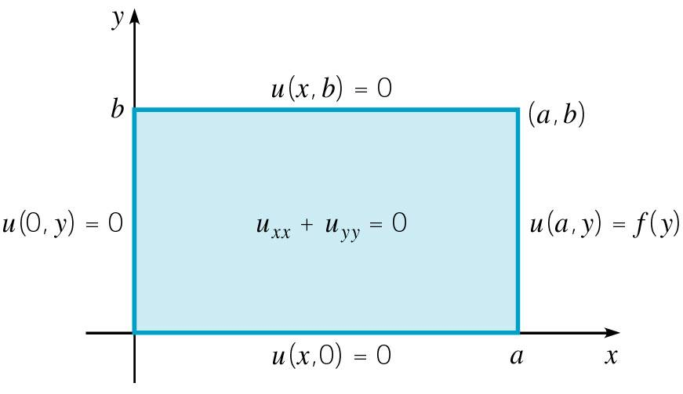
Boundary Conditions (2 of 4)
Recall the heat conduction problem in a bar:
Note that it is necessary to prescribe one condition at each end of the bar, that is, one condition at each point on the boundary.
Generalizing this observation to multidimensional problems, it is natural to prescribe one condition
on u at each point on boundary of
region in which a solution is sought.

Slide 5
Common Types of Boundary Conditions (3 of 4)
The most common boundary condition occurs when the value of u is specified at each boundary point.
In terms of the heat conduction problem, this corresponds to prescribing the temperature on the boundary.
In some problems the value of the derivative, or rate of change, of u in the direction normal to the boundary is specified instead.
For example, the condition on the boundary of a thermally insulated body is of this type.
More complicated boundary conditions can occur as well. For example, u might be prescribed on part of the boundary and its normal derivative specified on the remainder.

Slide 6
Dirichlet and Neumann Conditions (4 of 4)
The problem of finding a solution of Laplace’s equation that takes on given boundary conditions is known as a Dirichlet problem.
The problem of finding a solution of Laplace’s equation for which values of the normal derivative are prescribed on the boundary is known as a Neumann problem.
The Dirichlet and Neumann problems are also known as the first and second boundary value problems of potential theory.
Existence and uniqueness of the solution of Laplace’s equation under these boundary conditions can be shown, provided that the shape of the boundary and the functions appearing in the boundary conditions satisfy certain very mild requirements.

Slide 7
Dirichlet Problem for a Rectangle (1 of 8)
Consider the following Dirichlet problem on a rectangle:
where f is a given function on 0 ≤ y ≤ b.

Slide 8
Separation of Variables Method (2 of 8)
We begin by assuming
Substituting this into our differential equation
we obtain
or
where λ is a constant.
We next consider the boundary conditions.

Slide 9
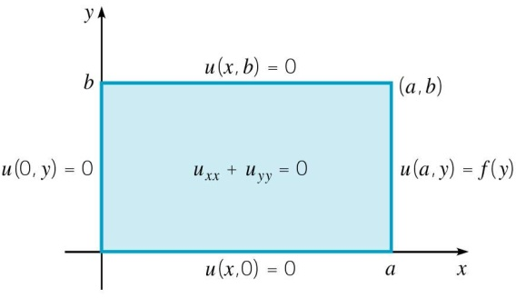
Boundary Conditions (3 of 8)
Our Dirichlet problem is
Substituting u(x,y) = X(x)Y(y) into the homogeneous boundary conditions, we find that

Slide 10
Eigenvalues and Eigenfunctions (4 of 8)
Thus we have the following two boundary value problems:
As shown previously in this chapter, it follows that
With these values for λ, the solution to the equation
is
where k₁, k₂ are constants. Since X(0) = 0, k₁ = 0, and hence

Slide 11
Fundamental Solutions (5 of 8)
Thus our fundamental solutions have the form
where we neglect arbitrary constants of proportionality.
To satisfy the boundary condition at x = a,
we assume
where the c_{n} are chosen so that the initial condition is satisfied.

Slide 12
Initial Condition (6 of 8)
Thus
where the c_{n} are chosen so that the initial condition is satisfied:
Hence
or

Slide 13
Solution (7 of 8)
Therefore the solution to the Dirichlet problem
is given by
where

Slide 14
Rapid Convergence (8 of 8)
Our solution is
where
For large n, sinh(x) = (e^{x} – e^{-x})/2 ≅ (e^{x})/2 and hence
Thus this factor has the character of a negative exponential.
The series representation of u(x,t) above therefore converges rapidly unless a – x is very small.

Slide 15
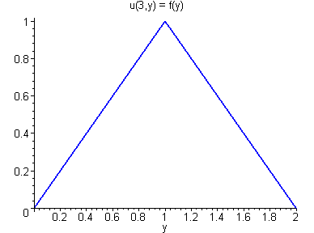
Example 1: Dirichlet Problem (1 of 2)
Consider the vibrating string problem of the form
where

Slide 16
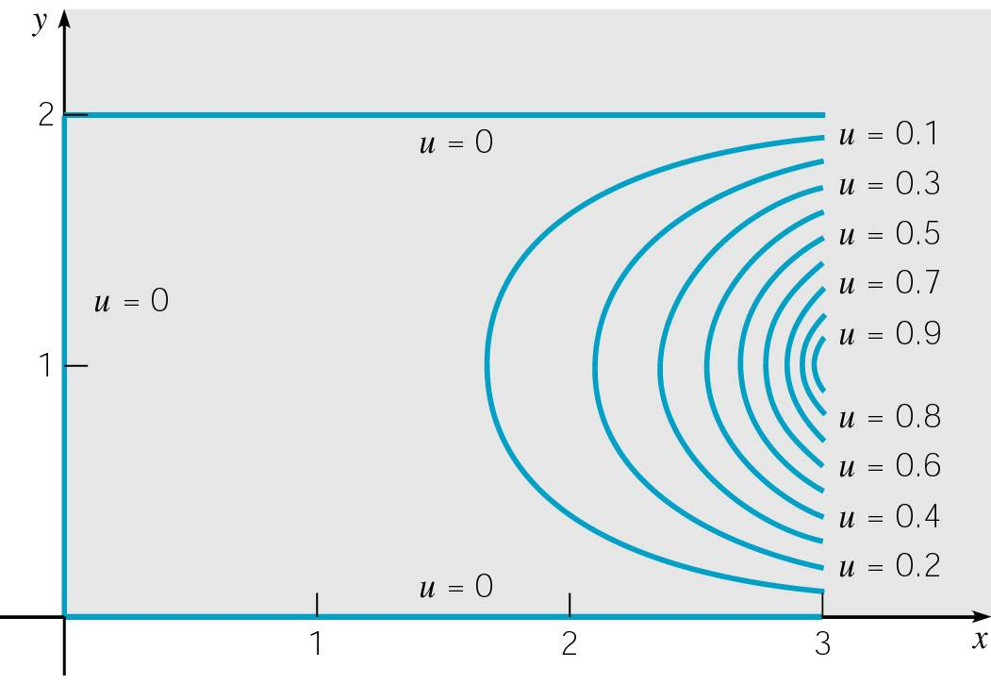
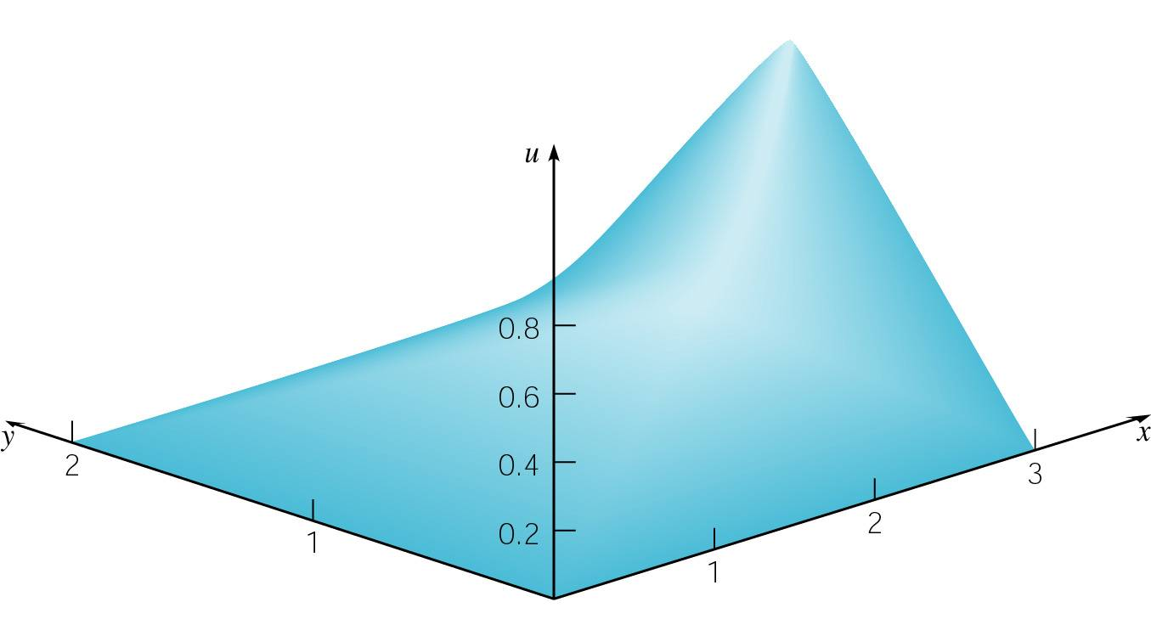
Example 1: Solution (2 of 2)
The solution to our Dirichlet problem is
A plot of u(x,y) is given below right, along with a contour plot showing level curves of u(x,y) on the left.

Slide 17
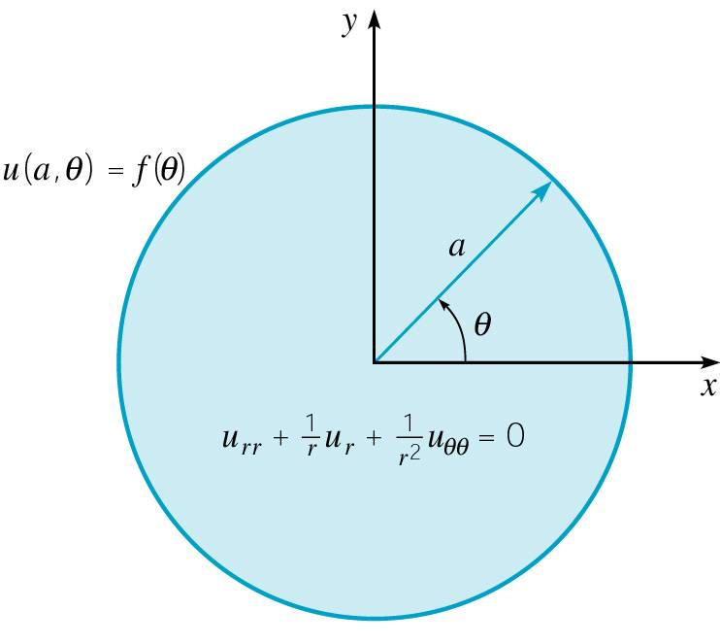
Dirichlet Problem on a Circle (1 of 8)
Consider problem of solving a Laplace’s equation on a circular region r < a subject to the boundary condition
where f is a given function. See figure below.
In polar coordinates, Laplace’s equation has the form
We require that u(r,θ) be periodic
in θ with period 2π, and that u(r,θ)
be bounded for r ≤ a.

Slide 18
Separation of Variables Method (2 of 8)
We begin by assuming
Substituting this into our differential equation
we obtain
or
where λ is a constant.

Slide 19
Equations for λ < 0, λ = 0 (3 of 8)
Since u(r,t) is periodic in θ with period 2π, it can be shown that λ is real. We consider the cases λ < 0, λ = 0 and λ > 0.
If λ < 0, let λ = -μ² where μ > 0. Then
Thus Θ(θ ) periodic only if c₁ = c₂ = 0; hence λ is not negative.
If λ = 0, then the solution of Θ = 0 is Θ = c₁ + c₂θ .
Thus Θ(θ ) periodic only if c₂ = 0; hence Θ(θ ) is a constant.
Further, the corresponding equation for R is the Euler equation
Since u(r,t) bounded for r ≤ a, k₂ = 0 and thus R(r) is constant.
Hence the solution u(r,θ) is constant for λ = 0.

Slide 20
Equations for λ > 0 (4 of 8)
If λ > 0, let λ = μ² where μ > 0. Then
Thus Θ(θ ) periodic with period 2π only if μ = n, where n is a positive integer.
Further, the corresponding equation for R is the Euler equation
Since u(r,t) bounded for r ≤ a, k₂ = 0 and thus
It follows that in this case the solutions take the form

Slide 21
Fundamental Solutions (5 of 8)
Thus the fundamental solutions of
are, for n = 1, 2, …,
In the usual way, we assume that
where c_{n} and k_{n} are chosen to satisfy the boundary condition

Slide 22
Boundary Condition (6 of 8)
Thus
where c_{n} and k_{n} are chosen to satisfy the boundary condition
The function f may be extended outside the interval 0 ≤ θ < 2π so that it is periodic with period 2π, and therefore has a Fourier series of the form above.
We can therefore compute the coefficients c_{n} and k_{n} using the Euler-Fourier formulas.

Slide 23
Coefficients (7 of 8)
Since the periodic extension of f has period 2π, we may compute the Fourier coefficients by integrating over any period of the function.
In particular, it is convenient to choose (0, 2π ).
Thus for
we have

Slide 24
Solution (8 of 8)
Therefore the solution to the boundary value problem
is given by
where
A full Fourier series is required here, as the boundary data were given on 0 ≤ θ < 2π and have period 2π.

