Slide 1

Bachelor of Science in
Mathematics and Economics
JUPAS Code: JS5813
A Program jointly offered by
School of Science and
School of Business & Management

Slide 2

Why Mathematics and Economics?

Slide 3
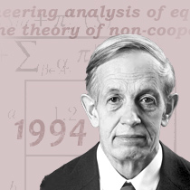
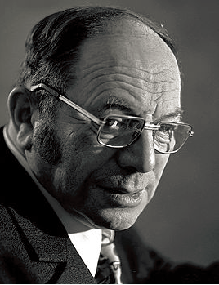
Nobel Laureates in Economics
The research for Nobel Laureates in Economics heavily require mathematics.
Mathematician John Nash Jr., whose work on the game theory changed modern economics, won the Nobel Prize in Economics in 1994.
  Nash equilibrium: Prisoner’s Dilemma.
Mathematician Leonid Kantorovich, known for his theory and development of techniques for the optimal allocation of resources, and regarded as the founder of linear programming., won the Nobel Prize in Economics in 1975.

Slide 4
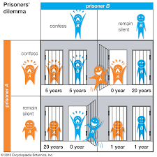

Slide 5
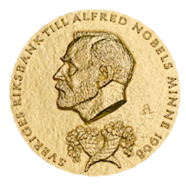
Nobel Laureates in Economics
21 out of 45 Laureates awarded in the last 25 years have degree(s) in Mathematics
2016 | Oliver Hart | B.A. Math
2016 | Bengt Holmström | B.S. Math, M.Sc. Operations Research
2013 | Lars Hansen | B.S. Math, Political Science
2012 | Alvin Roth | B.S., M.S., Ph.D. Operations Research
2012 | Lloyd Shapley | A.B. Math, Ph.D. in Mathematics
2011 | Christopher Sims | A.B. Math
2010 | Peter Diamond | B.A. Math
2007 | Eric Maskin | A.B. Math, Ph.D. Applied Math
2005 | Robert Aumann | B.S., M.S., Ph.D. Math
2004 | Edward Prescott | B.A. Math, M.S. Operations Research
2003 | Clive Granger | B.A. Math, Ph.D. Statistics
2002 | Daniel Kahneman | B.A. Math, Psychology
2001 | Michael Spence | B.A., M.A. Math
2001 | Joseph Stiglitz | B.A. Math, Economics
2000 | James Heckman | B.A. Math
1997 | Robert Merton | B.S. Engineering Math, M.S. Applied Math
1996 | William Vickrey | B.S. Math
1996 | James Mirrlees | M.A. Math
1994 | John Nash | B.S., M.S., Ph.D. Math
1994 | Reinhard Selten | M.S., Ph.D. Math
1992 | Gary Becker | B.A. Math
x

Slide 6
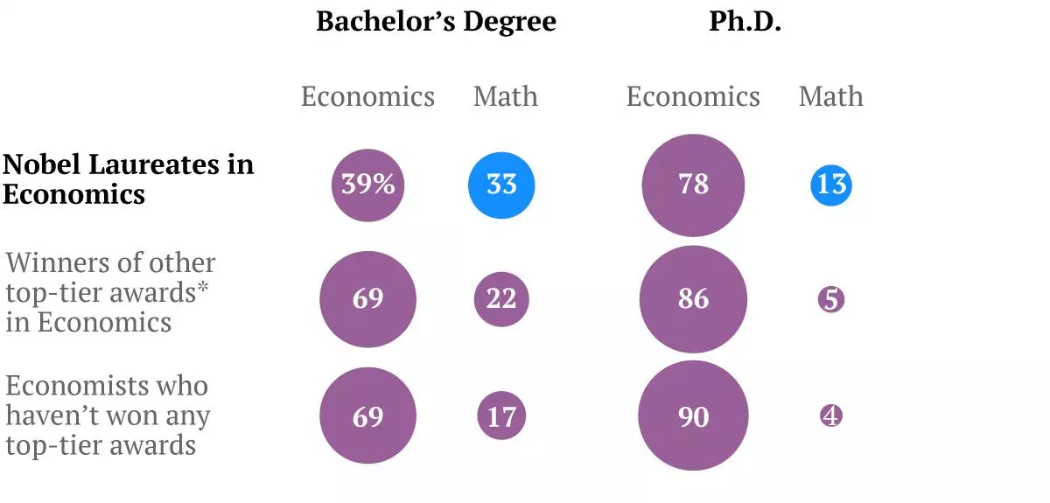

Slide 7
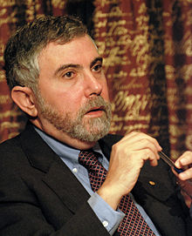

Paul Krugman - Nobel Laureate
“The mathematical grinding serves an essential function — that of clarifying thought.”
“After the mathematics, I was able to express most of those ideas in plain English. It really took the mathematics to get there, and you still cannot quite get it all without the equations.”
Nobel Prize in Economic Sciences 2008

Slide 8
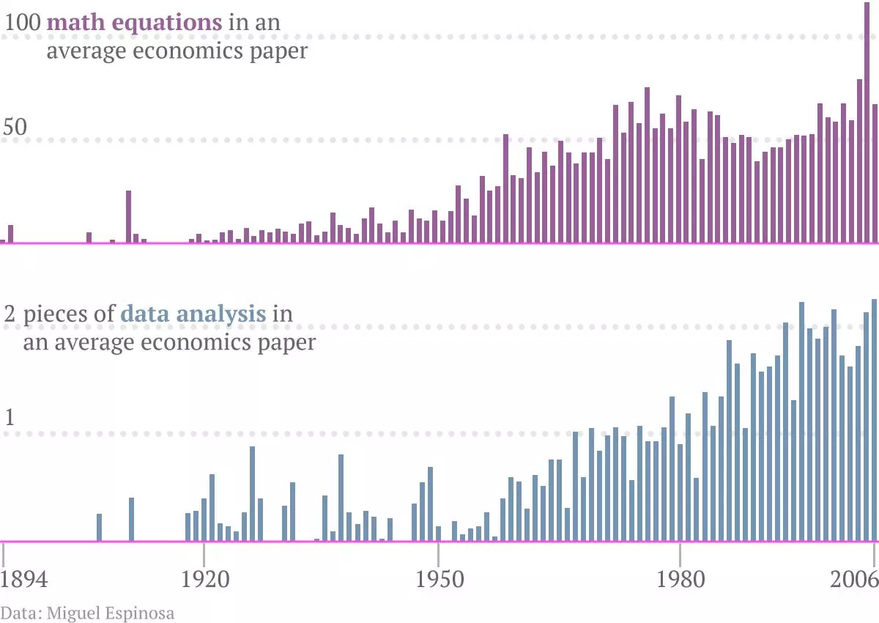
An average published paper in the field includes more than 50 equations (like GDP = C + I + G + X – M) and about 2 pieces of data analysis.

Slide 9
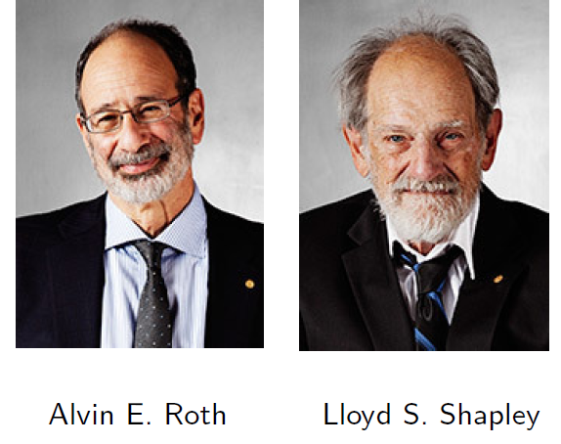
Nobel Awards on Matching Schemes
2012 Nobel Awards in Economics go to Shapley and Roth on their works on matching schemes

Slide 10
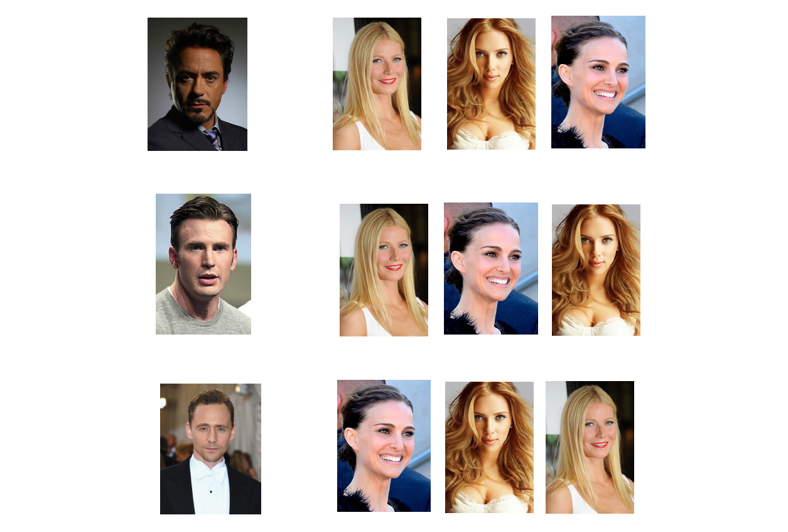

Slide 11
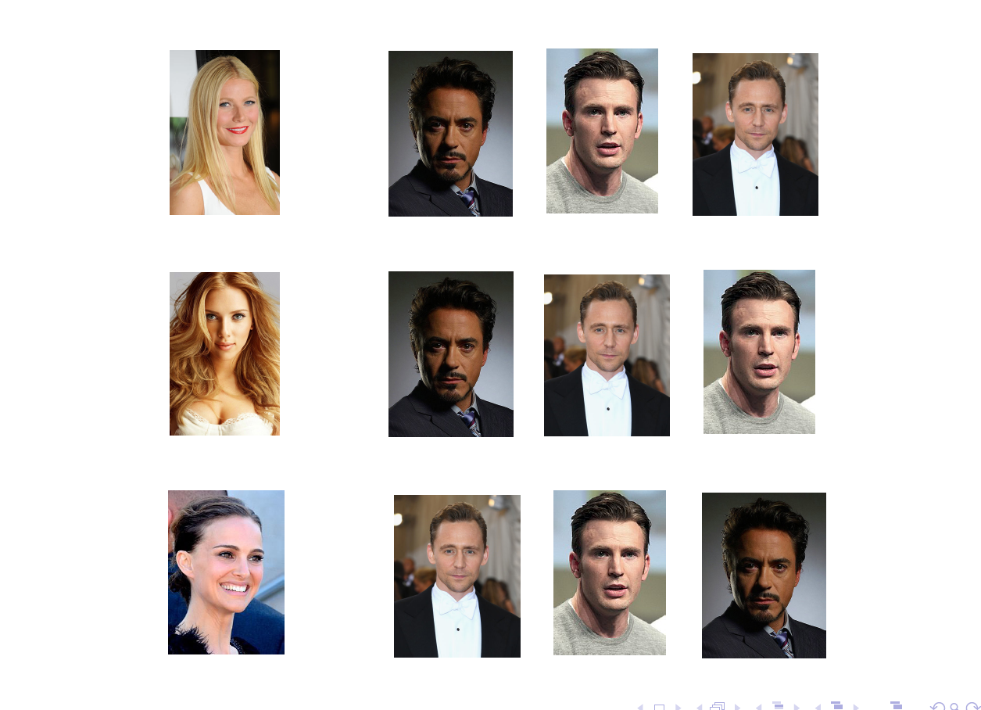

Slide 12
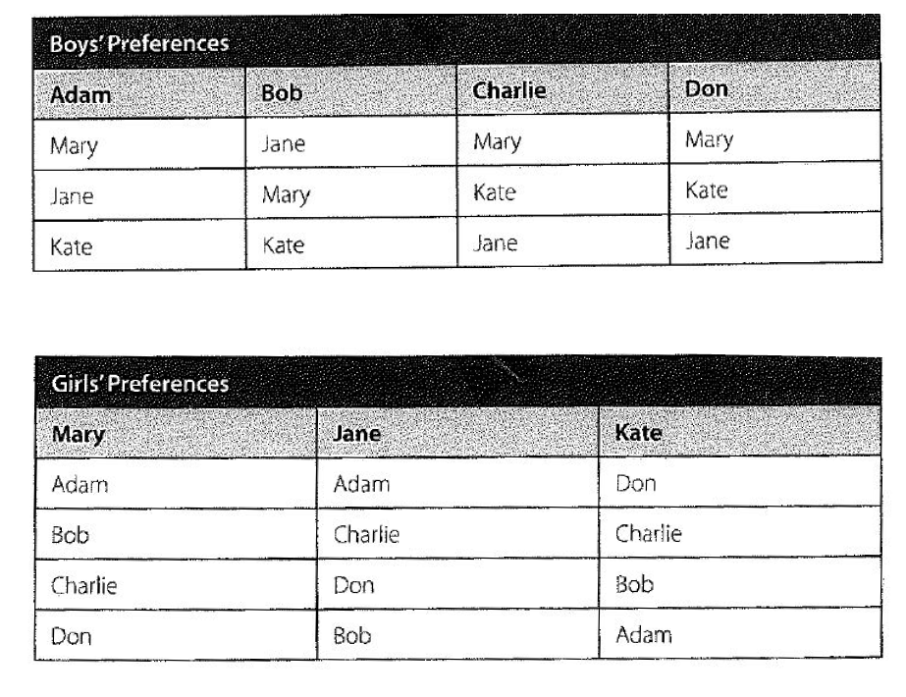
Example

Slide 13
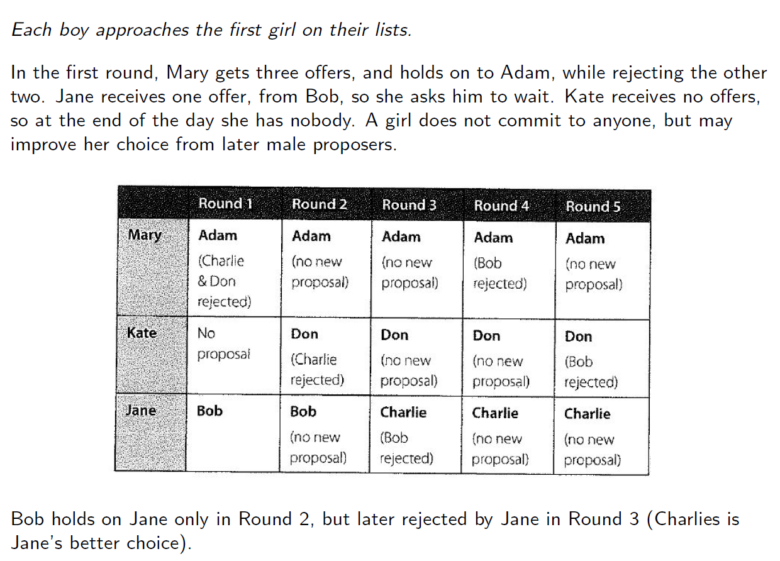

Slide 14
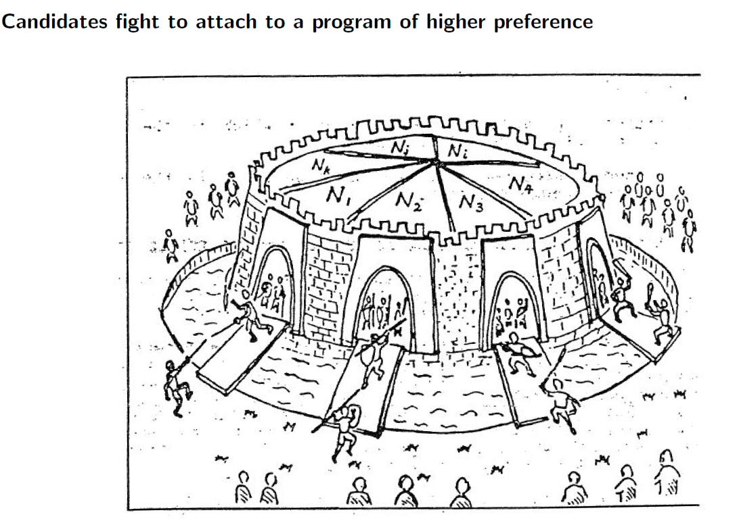
College admission: Student optimal

Slide 15
Candidates optimal:
Deferred acceptance by programs
A solider tries to break into the castle through one of the gangways (in order of his preference). When a compartment in full, then intruder will ﬁght with the weakest person admitted in a tournament.
  The intruder is victorious by kicking out the weakest occupant.
  The intruder is defeated, he will try the next preferred gangway (until having exhausted all his choices).
Each student can be admitted at most into one program. He tries to attach to one of his dreamed programs in his order of preferences. However, he may be knocked out by a stronger competitor which is ranked higher than him by the program.
The Student Optimal Stable Solution has been used by JUPAS.

Slide 16
Desirable properties
Absence of justiﬁed envy
There is no unmatched student-school pair (i,s), where student i prefers school s to her assignment and she has higher priority than some other student who is assigned a seat at school s.
Strategy-proofness
Truthful preference revelation is a dominant strategy for the students. Under the current practice of JUPAS in Hong Kong, where choices of programs are categorized into different bands, universities may beneﬁt by manipulating its preferences.

Slide 17
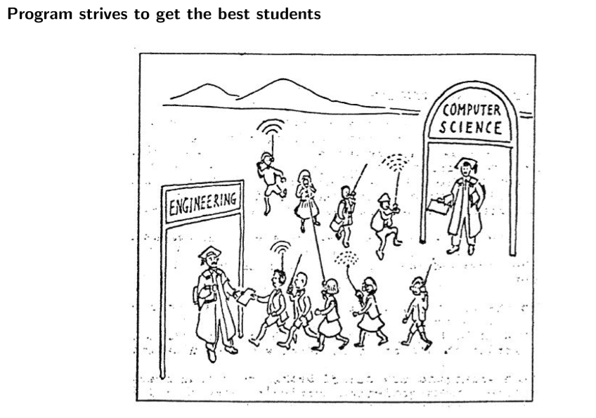
College admission: Program optimal

Slide 18
Programs optimal:
Deferred acceptance by candidates
Each admissions officer gives out all the K offers to the top K
candidates.
If there are more than one offer is given to the candidate, then they candidate returns the less preferred offers to the admissions officers, who will then give them to the next eligible candidates in the queues. No candidate holds more than one offer.

Slide 19
MAEC Curriculum

Slide 20
Highlights
Unique degree program in Hong Kong that combines Mathematics and Economics in one degree of study.
Broad-based education versus professional training (Quantitative Finance, Actuarial Science, Risk Management).
    Beneficial to the long-term career success
    Although specific techniques may become out of date, the ability to think analytically is something that remains with you for the rest of your life, enabling you to adapt to new developments in your chosen career.
Prepare students for research studies in economics / finance, or professional programs in financial engineering, data science, etc.

Slide 21

Learning Goals
Students who seek the option of taking a quantitatively oriented job in the banking & finance industry:
  Economics provides the problems from everyday life
  Mathematics provides the analytic tools to derive the intelligent answers beyond intuition
Those who plan to pursue further study in statistics, economics, finance, data analytics, etc.
  Top graduate schools will expect to see a lot of mathematics and economics courses on the undergraduate transcript.
x

Slide 22
Curriculum Design
Basic mathematics courses in calculus, statistics and linear algebra.
Tailored-made courses in calculus-based macroeconomics and microeconomics, econometrics.
Business core courses in accounting, finance.
In-depth ECON electives in banking, investment, and financial systems.
Free-electives to allow flexibility: More in-depth studies in Economics, Statistics, Financial Mathematics, or minor in Actuarial Science, Big Data Technology.

Slide 23
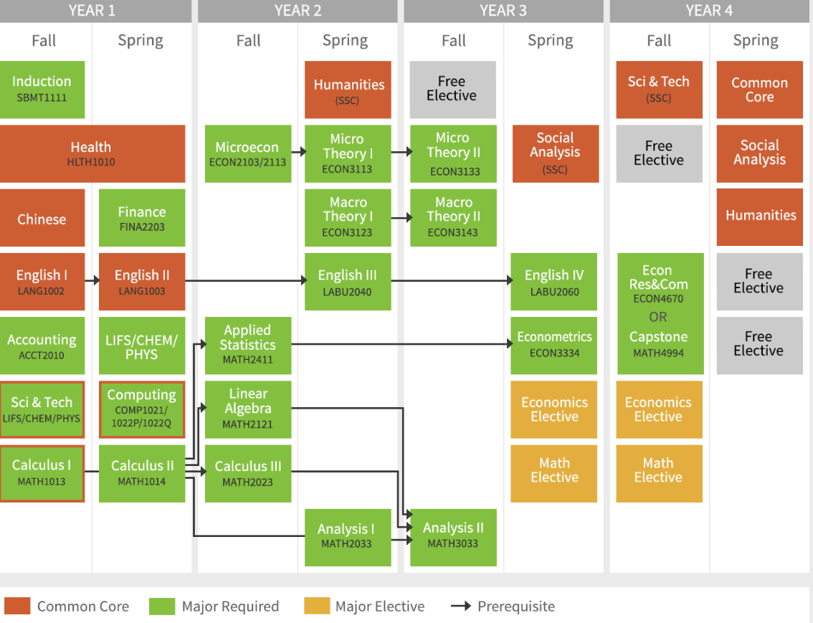
Normative Study Pathway
(2018-19 Year 1 Entry; program-based)

Slide 24
In-depth MATH Electives in Financial Mathematics
Financial
Mathematics
Fundamentals of Mathematical Finance
Quantitative Methods for Fixed Income Derivatives
Loss Models and Credibility Theory
Life Contingencies Models and Insurance Risk

Slide 25
In-depth ECON Electives in Banking, Investment & Financial Systems
Banking, Investment & Financial Systems
Time Series Econometrics and Business Forecasting
International Trade and Finance
International Trade and Investment
Globalization: Trade, Investment and Exchange
Money and Banking
International Macroeconomics and Finance

Slide 26
What Our Students Say
Siqi LI (Year 4) With both quantitative and analytical skills as well as business background, my Mathematics and Economics major equips me well for further postgraduate study. There are numerous activities such as CEOs talks, career advising and trainings from both School of Science and School of Business. I participated in the MenTernship and HeadStart Program and was eventually given an Internship in Shanghai last summer. Moreover, the School of Science offers plenty of enrichment opportunities. I get more familiarized with the actual world and my passion for conducting further research on development economics is aroused through joining the SCI/NUCLEUS Social Service Team. Last year, I was offered an Exchange Program at University of California, Berkeley and it allowed me to exchange ideas with top scholars and students. It was amazing!

Slide 27
What Our Students Say
Feiting XU (Year 4) Mathematics and Economics are more closely related than we could imagine. The MAEC major guides us to utilize the rigorous and logical thinking in mathematics to analyze the practical problems in economic sense. The School of Science also provides a tremendous amount of support besides academic advising. I explore my career path by attending career training workshops, alumni sharing and academic seminars. I also have got the chance to study in Stanford University and Columbia University in United States, which I never expected before I joined HKUST. The exchange experiences are inspiring, and I became more mature and independent. To sum up, it is a wonderful experience studying MAEC in HKUST. You would get unforgettable memory here, like me!

Slide 28
What Our Students Say
Qinwen ZHAI (Year 4) If you are interested in theoretical economics and want to have a solid training in mathematics, then MAEC is definitely your best choice! If your career goal is to get a job in the finance industry, MAEC also offers you plenty of opportunities obtaining hands-on experience of finance jobs. For example, I am lucky to get a precious opportunity to work in Silicon Valley during my 2nd year summer break. That summer became a milestone for me, opened my horizons and let me connect with a lot of brilliant people in the US. And in my 3rd year, I got the chance to go to Columbia University for academic exchange. It was a wonderful experience. I got immersed in a totally different culture and learned about the academic environment in one of the top universities in the world. Without the support of MAEC, I won’t be able to have so many dazzling moments and I won’t be able to become who I am today. So, go for it if you want! You can be whoever you want yourself to be here, in MAEC.

Slide 29
Career Prospects

Slide 30
Broad-based Education versus Professional Training
MAEC graduates are equipped with
  Solid training in fundamental theories and tools in both mathematics and economics.
  Strong quantitative reasoning skills and conceptual understanding to economics issues.
  Ability to adapt to the newest developments in their chosen career.
  Readiness for taking a quantitatively oriented role in the banking & finance industry.

Slide 31
MAEC Graduates – Career Prospects
Graduation Year | Position / Company
2010 | VP, Index Structurer, Citi Fixed Income Indices
2011 | Senior Analyst, ANREV
2011 | Managing Director, Aron Capital Management Co Ltd
2011 | Director of Finance, MetLife
2011 | Data Scientist, Goggle
2011 | Senior Associate, KPMG

Slide 32
MAEC Graduates – Career Prospects
Graduation Year | Position / Company
2012 | Solution Sales Rep, HK & Taiwan, Promethean
2012 | Investment Manager, Sichuan Tianfu Bank
2012 | Associate Director, Temasek
2012 | Economist, Amazon
2012 | Software Engineer, Amobee
2012 | Private Banker, China Minsheng Banking Corp
2013 | Senior Manager, Agricultural Bank of China
2013 | Trader, BosValen Asset Management Ltd

Slide 33
MAEC Graduates – Career Prospects
Graduation Year | Position / Company
2014 | Analyst, Asian Special Situations Group Strategies, Goldman Sachs
2014 | Junior Quantitative Portfolio Manager, Merck Finck Privatbankiers AG
2014 | Senior Quantitative Analyst, S&P Global
2014 | Sr. Legal Executive, Nicky Chen & Partners
2015 | Senior Executive, Public Mutual Berhad
2015 | Credit Strategist, Goldman Sachs
2015 | Associate, JP Morgan
2015 | Software Engineer, Microsoft

Slide 34
MAEC Graduates – Career Prospects
Graduation Year | Position / Company
2016 | Private Equity Associate, Bain Capital
2016 | Investment Analyst, AQUMON (Magnum Research)
2016 | Business Analyst, CJC Ltd - Technical and Commercial Market Data Managed Services
2016 | Senior Investment Manager, Hong Kong International Investment
2016 | Research Fellow, Stanford Institute for Economics and Policy Research
2016 | Financial Analyst, Telstra International Group
2016 | Global Markets Analyst, Bank of America Merrill Lynch
2017 | Business Development & UX Manager, FeedMe Guru
2017 | Macro Research Analyst, Nomura
2017 | Fuji Xerox (Hong Kong) Consulting Executive - Global Services Business
2017 | Management Trainee, Commercial Banking, Hang Seng Bank
2017 | Risk Assurance Associate, PWC Hong Kong and Mainland China
2017 | IT Consultant, FDM Group
2017 | Tech risk management Analyst, UBS

Slide 35
Recent MAEC Graduates – Further Study
Yr of Graduation | Program Title/University
2017 | PhD in Statistics (University of Wisconsin, Madison) PhD in Biostatistics (University of Washington) MPhil in Economics (Oxford) MPhil in Economics (HKUST) MPhil in Computer Science and Engineering (HKUST) MPhil in Mathematics (HKUST) MSc in Operations Research (Columbia University) MSc in Finance (Johns Hopkins University) MA in Mathematics of Finance (Columbia University) MSc in Finance (MIT) MSc in Financial Engineering (Columbia University/New York University)

Slide 36
Recent MAEC Graduates – Further Study
Yr of Graduation | Program Title/University
2018 | PhD in Economics (Johns Hopkins University) PhD in Economics (Washington University) MPhil in Economics (University of Cambridge) MSc in Financial Engineering (Columbia University) MSc in Finance - Quantitative Track (Washington University) MSc in Financial Mathematics (HKUST) MA in Economics (New York University) MA in Social Science - Economics Track (University of Chicago)

Slide 37
Fixed Income Analyst
BOCHK Asset Management
Business Eng. Communication training
Responsibilities
Providing China, Asia and Global macroeconomic analysis
Performing currency and interest rate market analysis
Maintaining different in-house macroeconomic models
Presenting with investment ideas and sifting through the relevant information and using his/her judgment to recommend currency and interest rate investment strategies
Assisting the establishment of macro investment strategy, implementing and maintaining strategic asset allocation
Specifications / Qualifications
Macroeconomic analysis experiences preferred
Strong skills to analyze currency, interest rate markets and/or sovereign credits
Good quantitative skills to handle and analyze large volumes of data; statistical skills are required
High standard Excel’s skills including programming
Handling multi-tasks under stressful environment
Good attention to details for high accuracy
Strong communication skills
_{Math training}
_{Econ training}
_{Applied Statistics course}

Slide 38
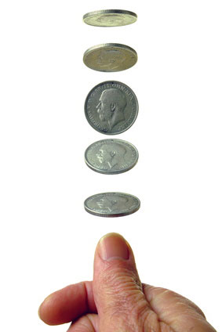

Typical interview questions for quants jobs in banks
Economic topics:
- Impact of acute drop / increase of oil price
- Quantitative easing
- Trade wars
Mathematical problems:
- Moving of objects
- Poker games
- Coin tossing
Test the sensitivity to economic issues and learning capabilities

Slide 39

What Our Graduates Say
 | Kristy LAW (Graduated in 2017) Management Trainee, Commercial Banking, Hang Seng Bank MAEC is an exhilarating journey, where I am benefited in different perspectives. Mathematics is intriguing and thought-provoking, especially when I am approaching some complex questions; whilst economics theories are profound and have a close nexus with a wide spectrum of real life issues. In MAEC, I have equipped with quantitative skills to address multifarious economic issues, received rigorous logical training, and understood the financial world more comprehensively, all of which are the key pillars of my career development. Furthermore, MAEC is a small cohort with strong bonding amongst students, where I came across many extraordinary and brilliant people within the program, learn from each other and gain more support. Benefited by the soft and hard skills acquired from this program, I become more competitive to pursue a career in the business world, especially the financial market.”

Slide 40
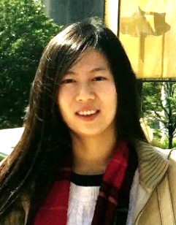
What Our Graduates Say
 | Keyu ZHANG (Graduated in 2016) Global Markets Analyst, Bank of America Merrill Lynch The study of economics helps me form a general view of the global economy and leads me to understand the financial market in a more comprehensive manner. The study of mathematics helps me to figure out the underlying investment opportunities in the financial markets and provides me a quantitative way of putting my ideas into actions. The flexibility of this program has allowed me to acquire other knowledge in accounting and finance, which makes me more competitive for my future career in the financial market.

Slide 41
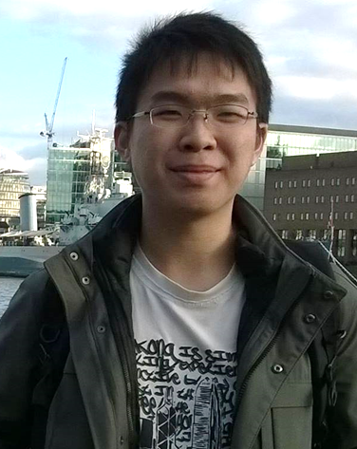
What Our Graduates Say
 | Kwok Yan CHIU (Graduated in 2016) Student in MSc Econometrics and Mathematical Economics at London School of Economics My long term career goal is to become an economist and I think the MAEC program had provided me a rigorous introduction to the modern economics and finance. With a few additional courses, I can easily meet the admission requirement for PG programs in quantitative economics and finance.

Slide 42
Interested?

Slide 43
Admission Routes
JUPAS Direct Entry (JS5813)
  HKDSE applicants with one of: M1 / M2 / Biology / Physics / Chemistry / Combined Science / Integrated Science
International Direct Entry
  Applicants with Int’l Qualifications (IBDP, GCEAL, SAT, etc.) with at least one senior level subject from: Mathematics / Biology / Chemistry / Physics
Transfer from Science (JS5100) or any Business School programs
SSCI/SBM students may choose to major in MAEC during major selection after completing Year 1

Slide 44
Admission Requirements for JUPAS-HKDSE Applicants
Minimum Levels Required for HKDSE:
Subject | Minimum Level Requirement
English Language | 4
Chinese Language | 3
Mathematics (compulsory) | 3
Liberal Studies | 2
Elective 1 One of: M1 / M2 / Biology / Physics / Chemistry / Combined Science / Integrated Science | 3
Elective 2 Any Category A subjects or M1/M2 | 3

Slide 45
Admission Requirements for JUPAS-HKDSE Applicants
Best 6 subjects with weighting which include:
Best Elective x 2
M1/M2
English x 2
Other Elective x 1.5
Economics
Math (Comp) x 2
Best Elective x 1.5
Biology / Chemistry / Physics /
Combined Science/
Integrated Science
Subject 1 | Weighted English Language
Subject 2 | Weighted Mathematics (Compulsory Module)
Subject 3 | Weighted Best Elective M1/M2 / Biology/ Chemistry/ Physics/ Combined Science/ Integrated Science
Subject 4, 5 & 6 | Next best 3 subjects Can be core OR any Category A subjects

Slide 46
Admission Scores (JUPAS)
 | English | Chinese | Math (Comp) | Liberal Studies | Elective 1 | Elective 2 | Elective 3 | M1/M2 | Admission Score
Median | 5 | 4 | 5** | 4 | 5* | 5* | - | - | 48
Lower Quartile | 4 | 4 | 5 | 3 | 5* | 5 | 5 | 5 | 47
2018
 | English | Chinese | Math (Comp) | Liberal Studies | Elective 1 | Elective 2 | Elective 3 | M1/M2 | Admission Score
Median | 4 | 5 | 5 | 4 | 5 | 5 | - | 5* | 47.5
Lower Quartile | 4 | 3 | 5** | 3 | 4 | 5 | - | 5 | 46.5
2017
 | English | Chinese | Math (Comp) | Liberal Studies | Elective 1 | Elective 2 | Elective 3 | M1/M2 | Admission Score
Median | 4 | 4 | 5* | 3 | 5 | 4 | 4 | 5 | 45
Lower Quartile | 4 | 4 | 5 | 5 | 4 | 4 | - | 5 | 43
2016

Slide 47
Admission Requirements for Applicants holding International Qualifications
In addition to fulfilling the University general admission requirement, applicants apply for:
MAEC program must have at least ONE Senior Level subject from
  Biology / Chemistry / Mathematics / Physics
GCE Advanced Level (AL) / International AL
High School graduation;
Final grades of **A in Science/Economics subjects
In which TWO AL Science/Economics subjects = A* (Chem/Bio/Math/Further Math/Pure Math/Econ) (At least ONE A* from Math/Further Math/Pure Math/Econ)
International Baccalaureate Diploma (IB)
Completion of IB Diploma;
Final grades 38 or above (including TOK)
In which ONE HL Science/Economics subject >= 6 (Math/Further Math/Econ) or
ONE HL Science subject >= 6 (Chem/Bio/Phys) and ONE SL subject >= 6 (Math/Further Math/Econ)

Slide 48
Final Information
  Failed in Chinese / English, any special consideration?
  NO, 332233 is the minimum University entrance requirements
  Accept combined certificates or not?
  Accept and without any penalty
Any bonus for interview?
  Yes, interview bonus will be given to applicants with good performance

Slide 49



Tel: (852) 2358 5065
Fax: (852) 2358 1464
Website: http://science.ust.hk
Email: ugscience@ust.hk

Slide 50
Questions & Answers
Thank you!

