Slide 2
Start Strong: WebAssign
What you’ll get:
Instructive videos to walk you through challenging problems
Learning tools and real-time feedback to help you track your understanding
An answer evaluator that knows when your work is correct and gives you credit
The Hong Kong University of Science and Technology
MATH 1012, 1013, 1014 & 2011
Let’s Get
Started

Slide 3
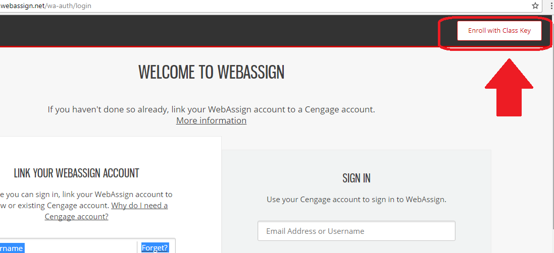
Get Access (New Students)
1. Go to https://webassign.net/login.html and click “Enroll with Class Key”.
Following is your class key:
ust.hk 4381 5397

Slide 4
Get Access (New Students)
2. Enter your class key and click Enroll

Slide 5
Get Access (New Students)
3. If the correct class and section is listed, click
Yes, this is my class.

Slide 6
Get Access (New Students)
4. Create your account if you are first time user.
Sign in if you already have an account.

Slide 7
Get Access (New Students)
5. Type the details for your new Cengage
account. Please use an institutional email address.
6. Read and acknowledge your acceptance of
the Cengage service agreement.
7. Click Create Account

Slide 8
Enter Access Code
8. You are signed in to WebAssign with your new
account and enrolled in your class
9. Click verify payment

Slide 9
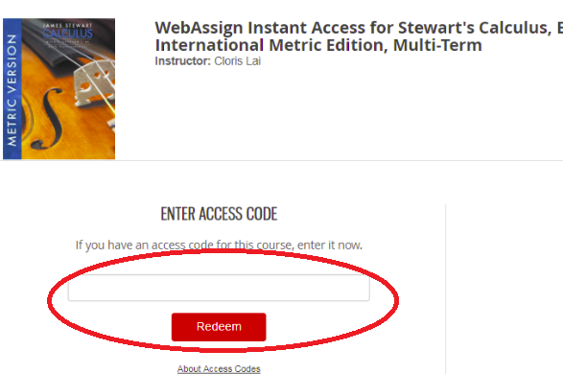
Enter Access Code
10. Enter WebAssign access code from your textbook and click redeem
( you shall obtain one access code when you purchase print book from campus bookshop)
.

Slide 10
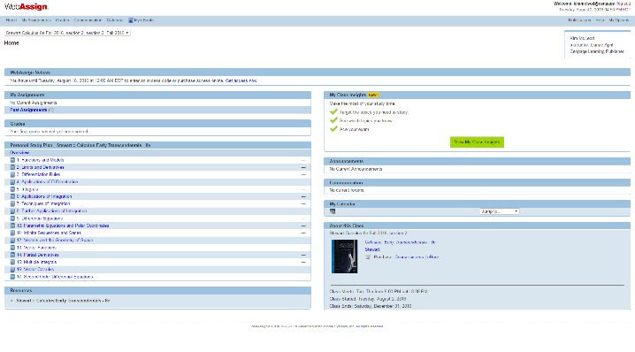
You’re All Set!
Your course(s) are shown on your WebAssign personalized home page.
If you are enrolled in more than one course, select the course you want to work with from the drop-down menu.

Slide 11
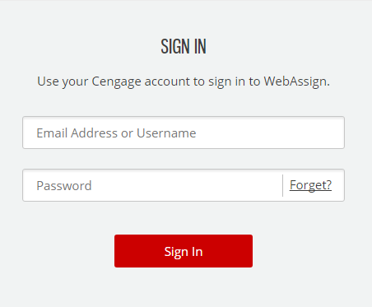
Future Sign In
For future access
1. Go to https://webassign.net/login.html
2. Type your Cengage username and password.
3. Click Sign In

Slide 12
Have Questions? We’re Here to Help!
Get Real-Time System Status with Techcheck!
Techcheck.cengage.com provides immediate insight into system performance, so you can quickly see if Cengage is experiencing technical difficulties. Online: www.cengage.com/support Email: asia.techsupport@cengage.com

